Slide 1


NEXT GEN EMPLOYABILITY PROGRAM
CREATING A FUTURE-READY WORKFORCE
Student Name :
Md Mahfooz Alam Ansari
Student ID :
STU64bec89eb7f7e1690224798
Mobile No:
+917980765039
Mail ID:
ansarimahfooz167@gmail.com
College Name :
Camellia School of Engineering & Technology

Slide 2
CAPSTONE PROJECT SHOWCASE
Project Title
Power BI Driven Exhaustive Analysis of Indian Agriculture Sector (DA)
Abstract | Problem Statement | Project Overview | Proposed Solution | Technology Used | Modelling & Results | Conclusion | Q&A

Slide 3
Abstract
1
Sustainable Growth Strategies: Leveraging Power BI insights, this project tailors sustainable growth plans for Indian agriculture, empowering the company while ensuring profitability and sustainability for both Company and farmers.
2
Informed Pricing Optimization: Derived from comprehensive data analyses, the project equips the company with competitive pricing strategies that benefit both the company and farmers, ensuring fair returns and market competitiveness.
3
Advocacy through Policy Insights: Distilling governmental policies, the project provides advocacy tools, shaping frameworks for industry sustainability and growth, ultimately benefiting farmers' livelihoods.
4
Efficiency Maximization in Operations: With Power BI's help, the project streamlines operations, optimizing resources and driving cost savings for the company while also increasing profitability for farmers through improved supply chain efficiency.

Slide 4


Problem Statement
In the heart of India's agricultural landscape, Amidst ongoing farmers' protests demanding Minimum Support Price (MSP), decreasing crop production over recent years India's agricultural sector faces the urgent challenge of balancing industry profitability with the welfare of farmers. These protests underscore the pressing need for fair compensation mechanisms. Leveraging Power BI's data analytics, this project aims to address this challenge by uncovering actionable insights, optimizing pricing strategies, and influencing policy frameworks to ensure farmers receive just compensation for their produce.
By enhancing operational efficiency and promoting equitable growth, the project seeks to establish a sustainable agricultural ecosystem. This approach benefits industry stakeholders and aligns with the demands of protesting farmers advocating for fair MSP. Through collaborative efforts, the project endeavors to foster a harmonious relationship between industry prosperity and the livelihoods of those toiling in the fields, thus contributing to a more equitable and resilient agricultural sector in India.

Slide 5

Project Overview
Title: Power BI Driven Exhaustive Analysis of Indian Agriculture Sector (DA)
Objective: The project aims to utilize Power BI's analytical capabilities to conduct a comprehensive analysis of the Indian agriculture sector. It seeks to uncover insights into crop production, market dynamics, government policies, and socioeconomic factors to inform decision-making processes and drive improvements in agricultural productivity and sustainability.
Approach: Through extensive data collection and analysis, the project will leverage Power BI's visualizations and data modeling features to generate actionable insights. It will explore patterns, trends, and correlations within the agriculture domain, facilitating informed decision-making and policy formulation.
Impact: By providing stakeholders with valuable insights and recommendations, the project endeavors to contribute to a better understanding of the challenges and opportunities in the Indian agriculture sector. Ultimately, it aims to support the development of data-driven strategies for sustainable growth and development in the industry.

Slide 6
Proposed Solution
The proposed solution involves harnessing the power of Power BI to conduct a comprehensive analysis of the Indian agriculture sector. By leveraging Power BI's advanced data visualization and analytics capabilities, the project aims to gather and process vast amounts of agricultural data, including crop production statistics, market trends, government policies, and socioeconomic indicators. Through meticulous analysis, the project will uncover valuable insights into the sector's dynamics, identifying key trends, patterns, and correlations that can inform strategic decision-making and policy formulation.
Furthermore, the project will focus on creating intuitive and actionable visualizations using Power BI, enabling stakeholders to easily interpret complex data and derive meaningful conclusions. By providing interactive dashboards and reports, the solution will empower decision-makers to identify opportunities for optimization, address challenges, and drive improvements in agricultural productivity and sustainability. Overall, the proposed solution seeks to transform the way stakeholders engage with agricultural data, facilitating informed decision-making and driving positive change in the Indian agriculture sector.

Slide 7
Technology used
Power BI

Slide 8
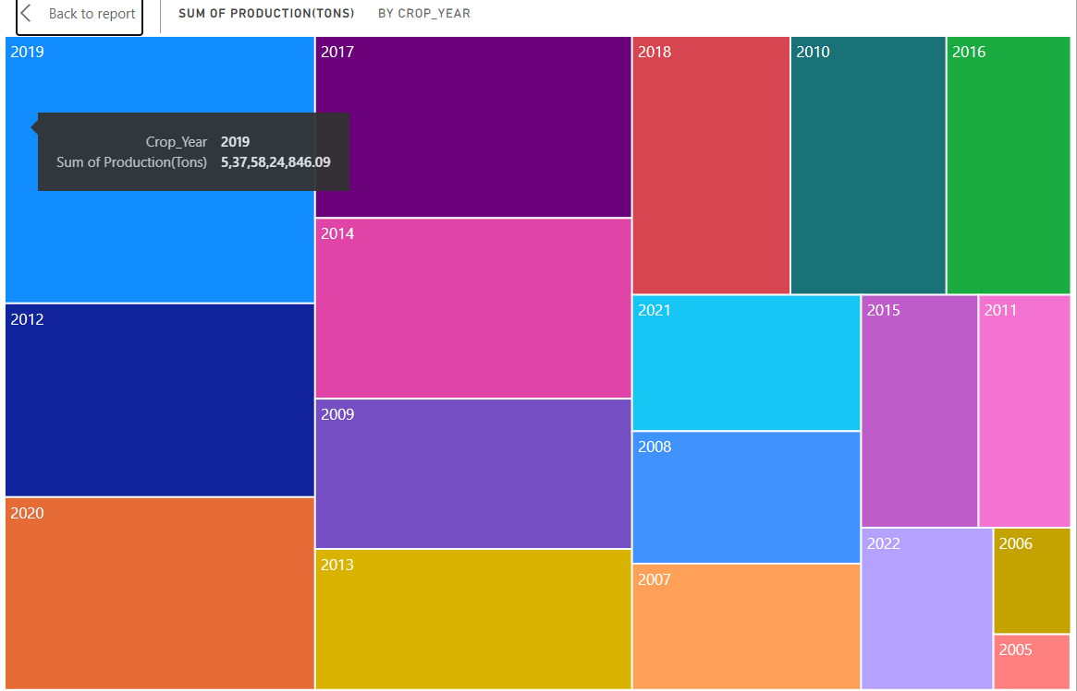
Modelling & Result

Slide 9
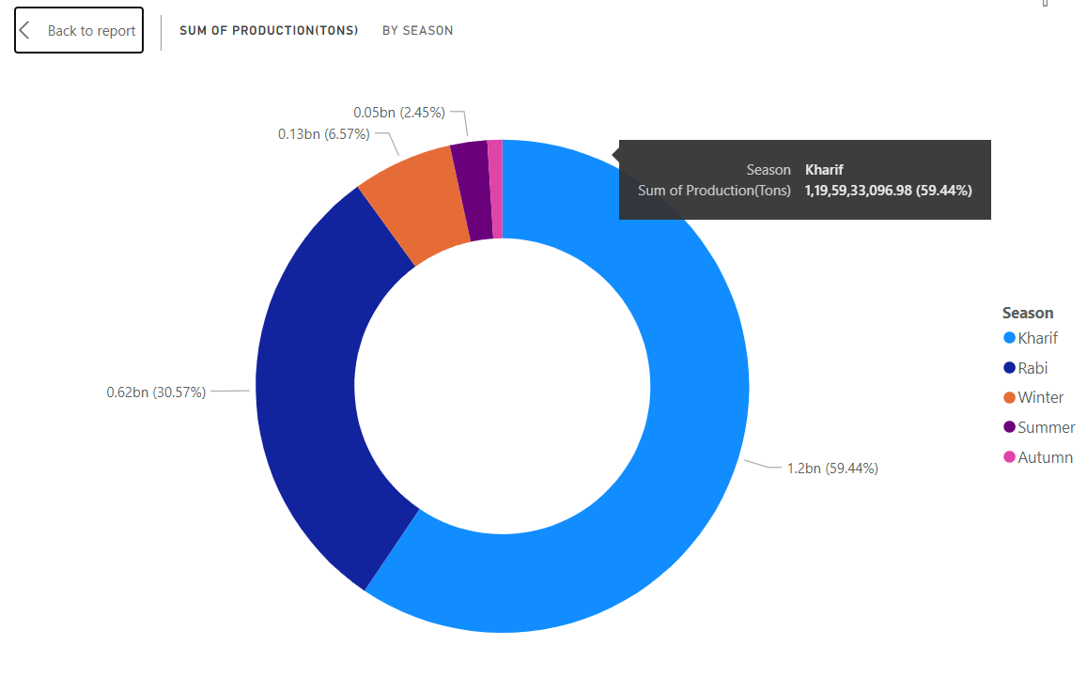
Modelling & Result

Slide 10
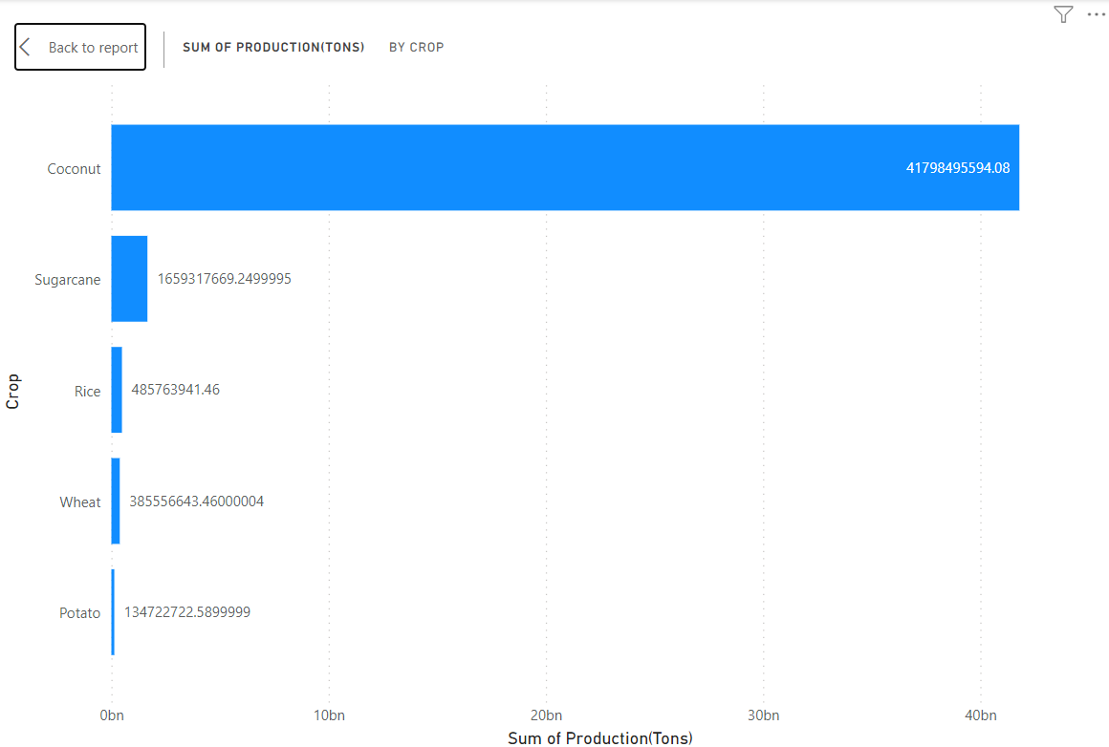
Modelling & Result

Slide 11
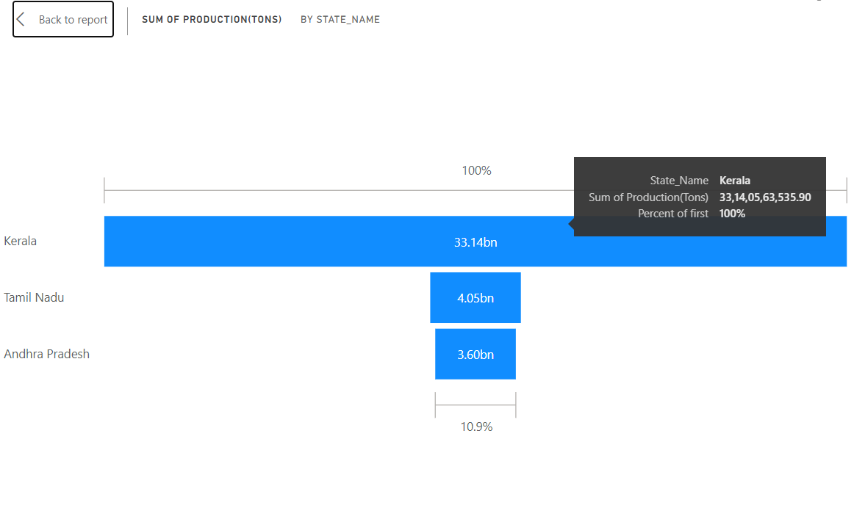
Modelling & Result

Slide 12
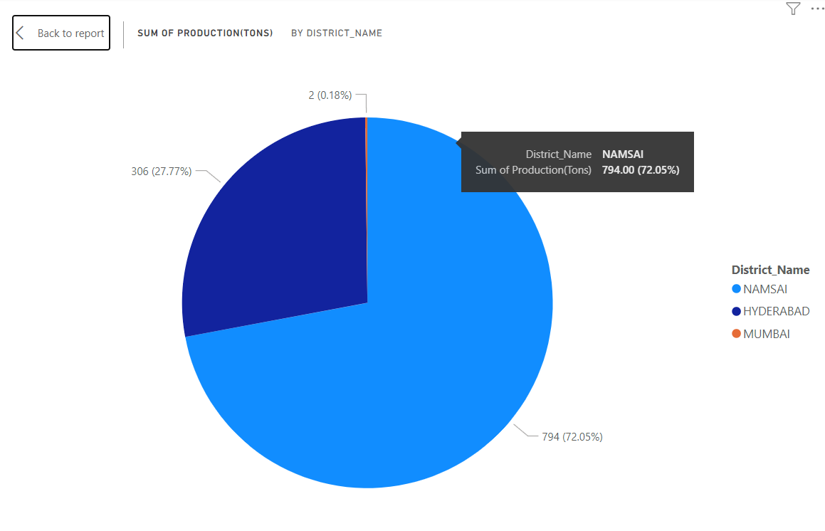
Modelling & Result

Slide 13
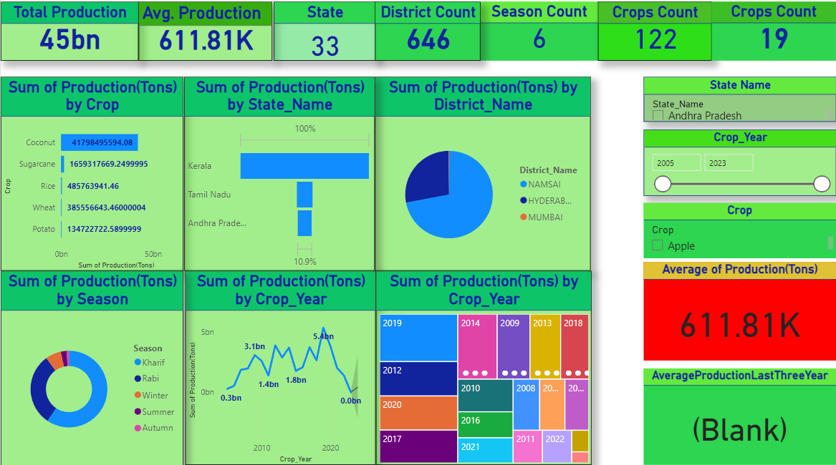
Modelling & Result

Slide 14

Conclusion
The insights garnered from the analysis of crop production trends in India offer a compelling narrative for the future trajectory of the agricultural sector. With 2019 marking the pinnacle of crop production, led by coconut, sugar cane, rice, wheat, and potato, it becomes imperative to delve deeper into the underlying factors driving this success. Integrating insights on Minimum Support Price (MSP), sustainability practices, livelihoods, and companies' profitability enriches our understanding and augments the project's significance.
In this context, the correlation between MSP implementation and crop production levels unveils the pivotal role of fair pricing mechanisms in incentivizing farmers and safeguarding their livelihoods. Concurrently, an examination of sustainability practices adopted by top-performing states and districts offers insights into strategies for fostering long-term agricultural resilience and environmental stewardship.
Furthermore, seasonal dynamics underscore the significance of aligning MSP policies and sustainability initiatives with crop production cycles. By considering these factors holistically, the project can offer nuanced recommendations for optimizing agricultural output while promoting the welfare and profitability of farmers.
The identification of Kerala, Andhra Pradesh, and Tamil Nadu as leading states in crop production underscores the need to analyze the interplay between MSP implementation, sustainability efforts, and companies' profitability. Understanding these dynamics at the district level, with Namsai, Hyderabad, and Mumbai emerging as top performers, provides localized insights for enhancing livelihoods and fostering sustainable growth.
By integrating MSP, sustainability, livelihoods, and companies' profitability into the analysis of crop production trends, the proposed project offers a comprehensive roadmap for stakeholders across the agricultural value chain. By aligning agricultural practices with principles of fairness, sustainability, and profitability, the project sets the stage for a more equitable, resilient, and prosperous agricultural sector in India.

Slide 15


Notes:
Thank You !!

